Slide 1

TLP Update
12/7/18 David Shaw/Vikki Espinosa

Slide 2
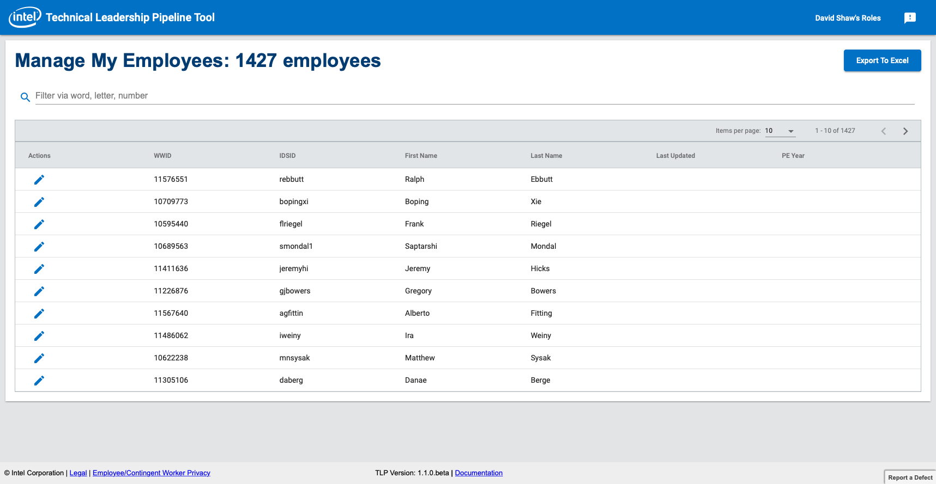
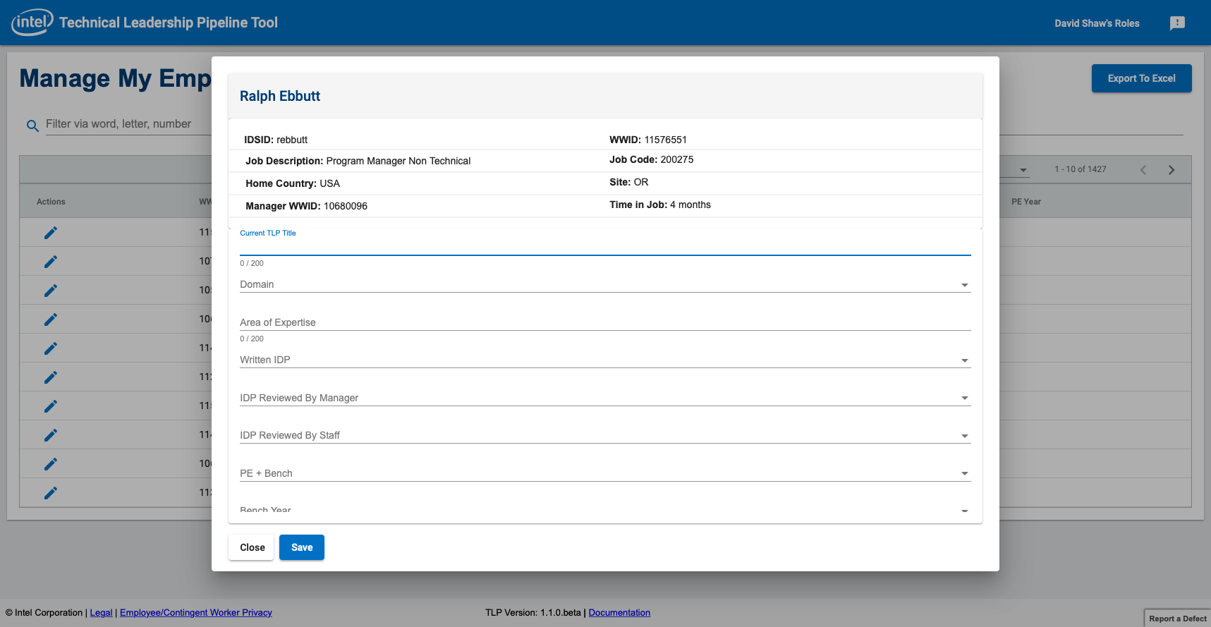
Update
# Bugs/ 100% Squashed.
33 CG Managers have updated - Roughly 77 PE candidates updated
Pending:
Production space buildout – Dependent on IT
Evaluation/Cost of 2 new requirements
Checkbox for user not in TLP
Add new field to grid to sort/filter by team
Challenges:
IT Bandwidth and lack of resources to help
Phase 1 MVP scaled back due to HR unwillingness to allow connect to workday data.
Innovation – first Intel application to be deployed to the internal cloud environment.

